Slide 1
SQL
Structured Query Language

Slide 2
SQL
SQL is a standard language for storing, manipulating and retrieving data in databases.
Popular Database: MySQL, SQL Server, MS Access, Oracle, Sybase, Postgres

Slide 3
Define Database?
A database is an organized collection of structured information or data, typically stored electronically in a computer system.
A database is usually controlled by a database management system (DBMS)

Slide 4
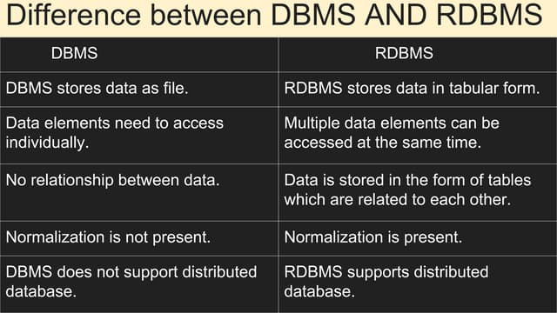
Database Management System (DBMS) is a software that is used to define, create, and maintain a database and provides controlled access to the data.

Slide 5
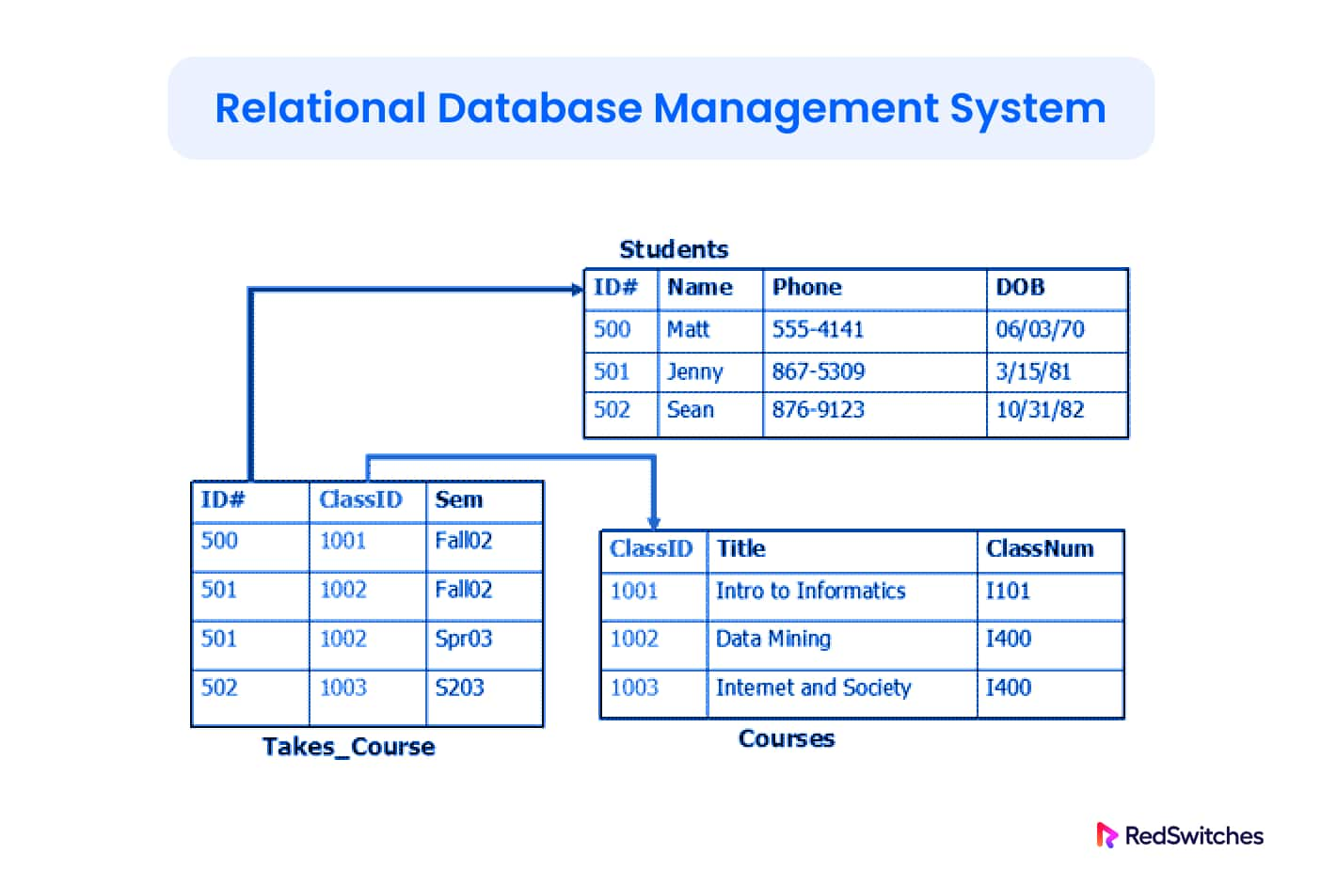

Slide 6
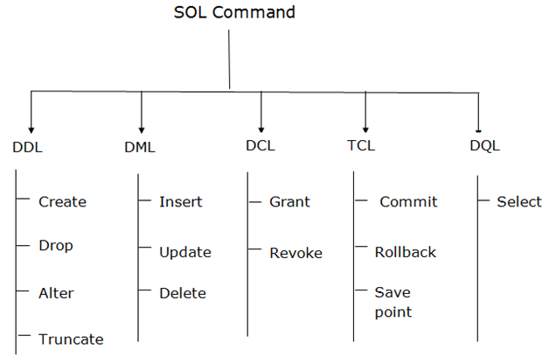

Slide 7
COMMAND | DESCRIPTION | SYNTAX
CREATE | Create database or its objects (table, index, function, views, store procedure, and triggers) | CREATE TABLE table_name (column1 data_type, column2 data_type, ...)
DROP | Delete objects from the database | DROP TABLE table_name;
ALTER | Alter the structure of the database | ALTER TABLE table_name ADD COLUMN column_name data_type;
TRUNCATE | Remove all records from a table, including all spaces allocated for the records are removed | TRUNCATE TABLE table_name;
COMMENT | Add comments to the data dictionary | COMMENT 'comment_text' ON TABLE table_name;
RENAME | Rename an object existing in the database | RENAME TABLE old_table_name TO new_table_name;

Slide 8
COMMAND | DESCRIPTION | SYNTAX
INSERT | Insert data into a table | INSERT INTO table_name (column1, column2, ...) VALUES (value1, value2, ...);
UPDATE | Update existing data within a table | UPDATE table_name SET column1 = value1, column2 = value2 WHERE condition;
DELETE | Delete records from a database table | DELETE FROM table_name WHERE condition;
LOCK | Table control concurrency | LOCK TABLE table_name IN lock_mode;
CALL | Call a PL/SQL or JAVA subprogram | CALL procedure_name(arguments);
EXPLAIN PLAN | Describe the access path to data | EXPLAIN PLAN FOR SELECT * FROM table_name;

Slide 9
COMMAND | DESCRIPTION | SYNTAX
BEGIN TRANSACTION | Starts a new transaction | BEGIN TRANSACTION [transaction_name];
COMMIT | Saves all changes made during the transaction | COMMIT;
ROLLBACK | Undoes all changes made during the transaction | ROLLBACK;
SAVEPOINT | Creates a savepoint within the current transaction | SAVEPOINT savepoint_name;

Slide 10
COMMAND | DESCRIPTION | SYNTAX
GRANT | Assigns new privileges to a user account, allowing access to specific database objects, actions, or functions. | GRANT privilege_type [(column_list)] ON [object_type] object_name TO user [WITH GRANT OPTION];
REVOKE | Removes previously granted privileges from a user account, taking away their access to certain database objects or actions. | REVOKE [GRANT OPTION FOR] privilege_type [(column_list)] ON [object_type] object_name FROM user [CASCADE];
COMMAND | DESCRIPTION | SYNTAX
SELECT | It is used to retrieve data from the database | SELECT column1, column2, ...FROM table_name WHERE condition;

